Slide 1
PSHS System Computer Science Summit 2
Day 3: Python in a Framework
Jason C. Alcarez Special Science Teacher III Technology Unit DOST-PSHS Main Campus

Slide 2
Language Frameworks
Software design templates and shortcuts*
Allow for more rapid application development
* Fayed & Schmidt, 1997; archived at http://www1.cse.wustl.edu/~schmidt/CACM-frameworks.html

Slide 3
Python Frameworks
TensorFlow, scikit-learn, PyTorch (for machine learning)
Tkinter, PyQT, PySimpleGUI (for GUI)
scipy, numpy, pandas (for computational sciences)
Django and Flask (for web-based applications)
https://kinsta.com/blog/python-frameworks/

Slide 4
Flask
Microframework for web applications for Python
Relies on third-party libraries to access data sources

Slide 5
Installing Flask
Prepare a Python virtual environment
Ensure pip is installed
Install Flask via pip

Slide 6
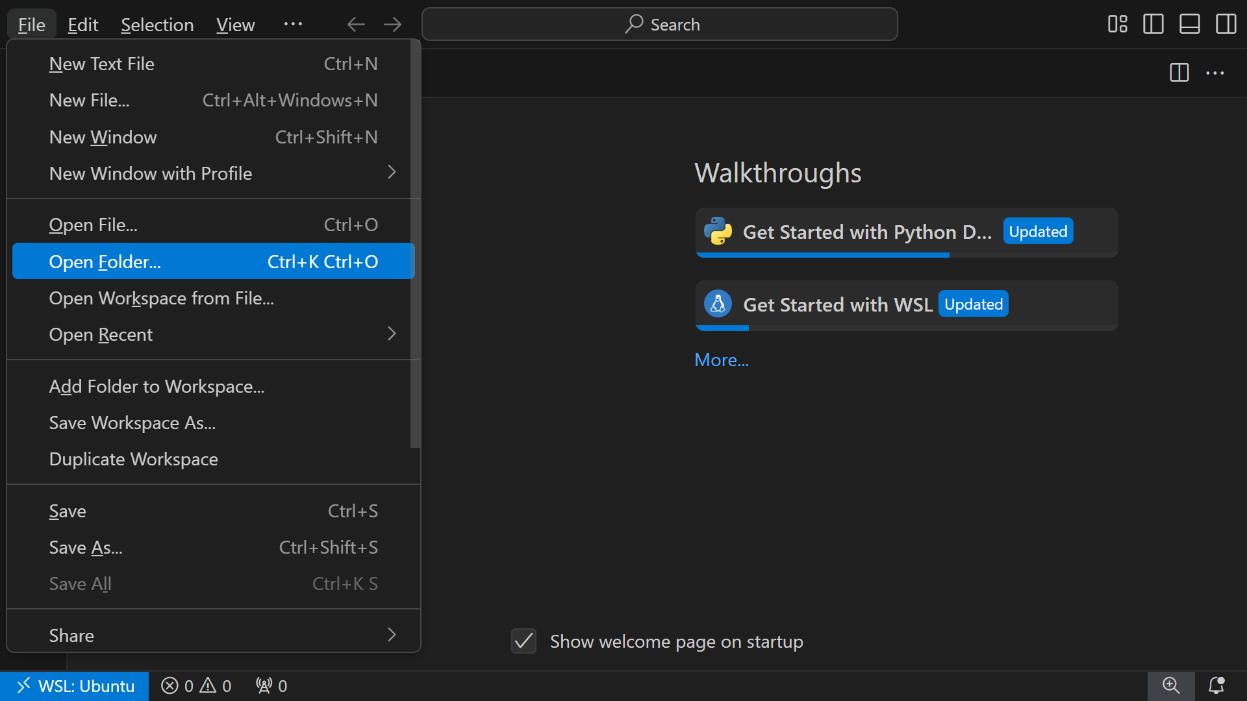

Slide 7
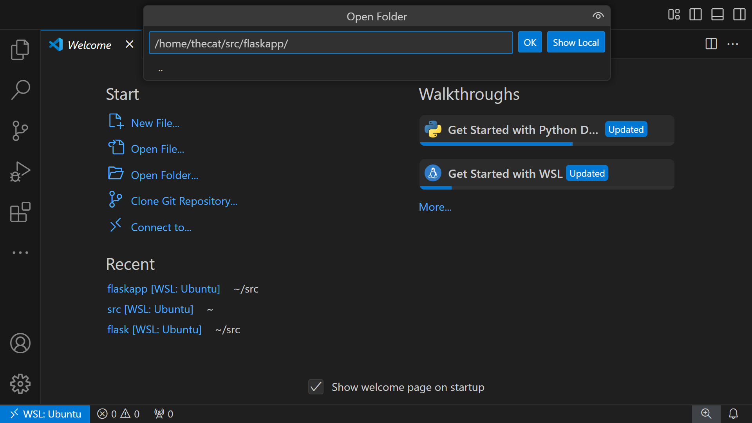

Slide 8
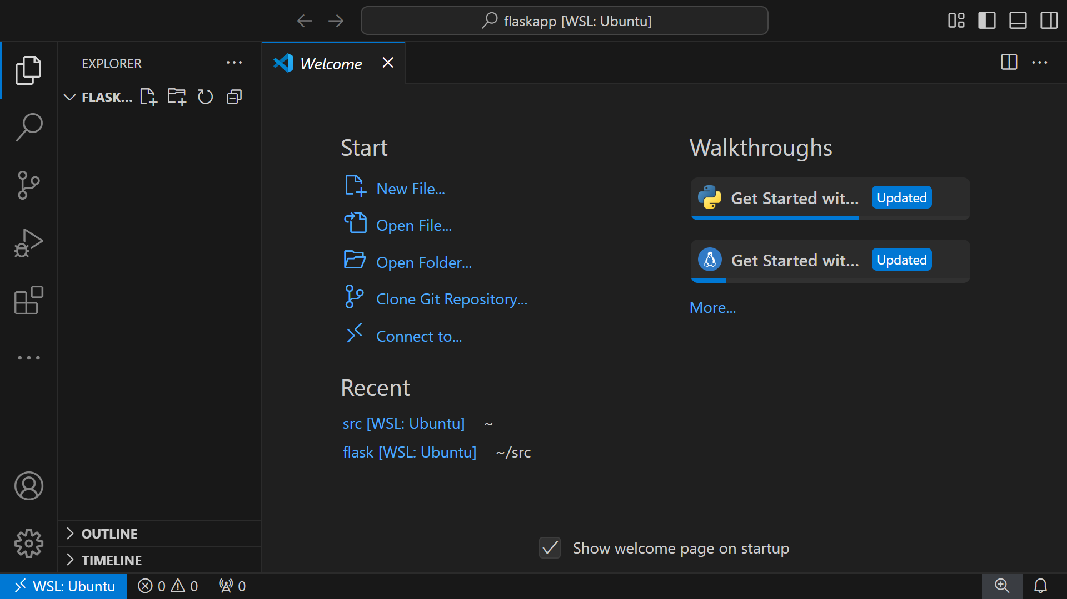

Slide 9
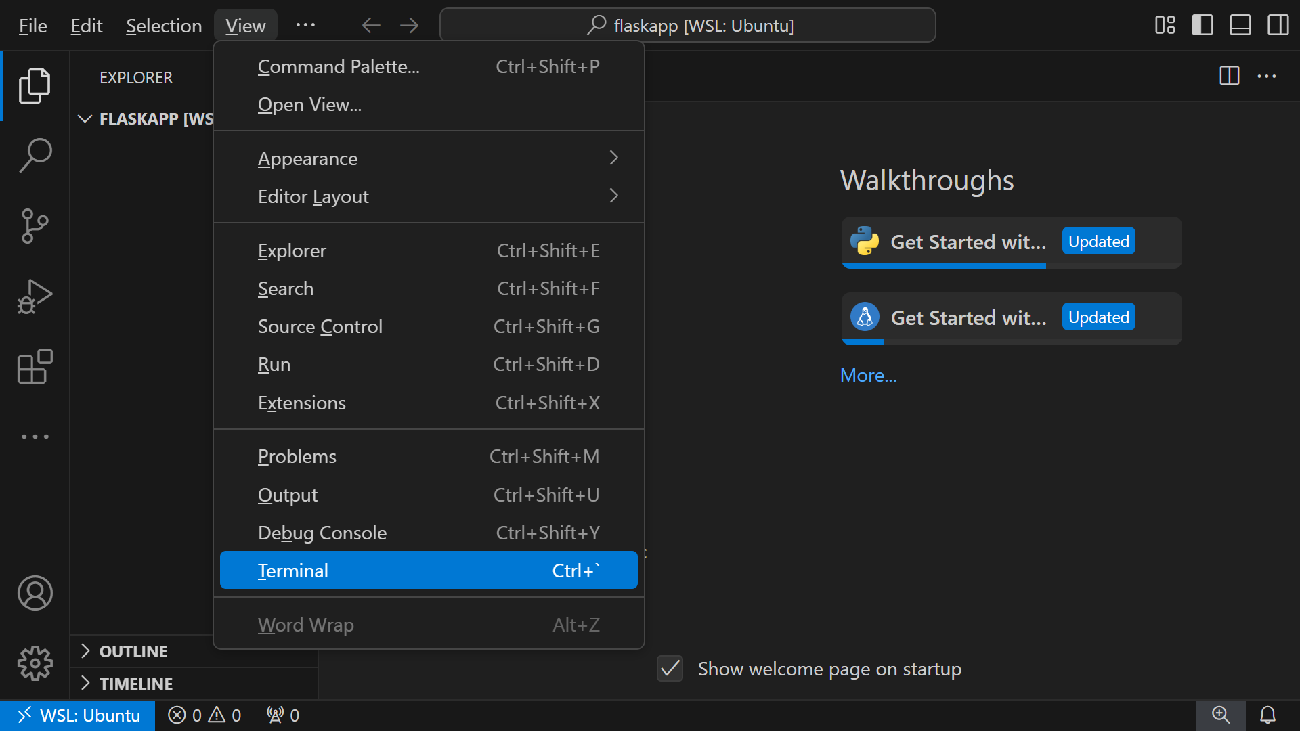

Slide 10
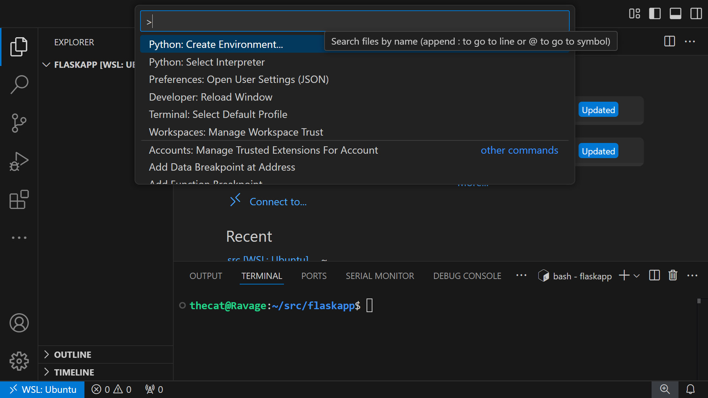

Slide 11
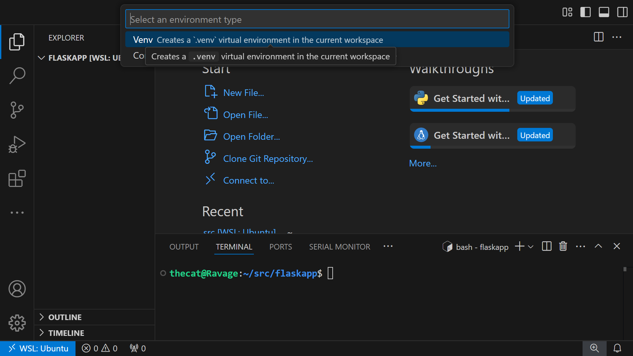

Slide 12
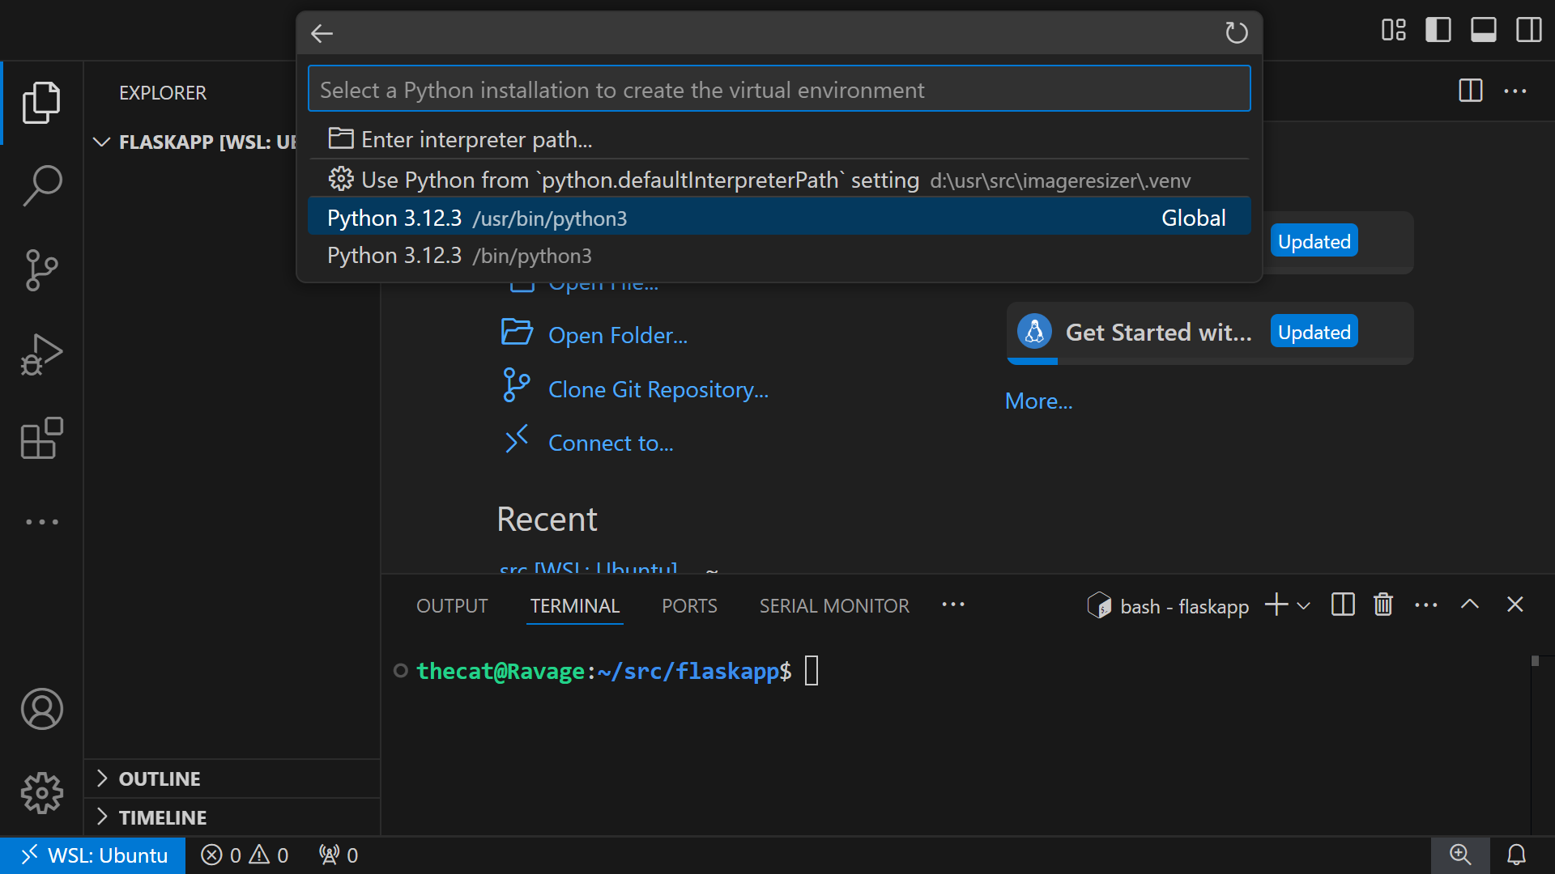

Slide 13
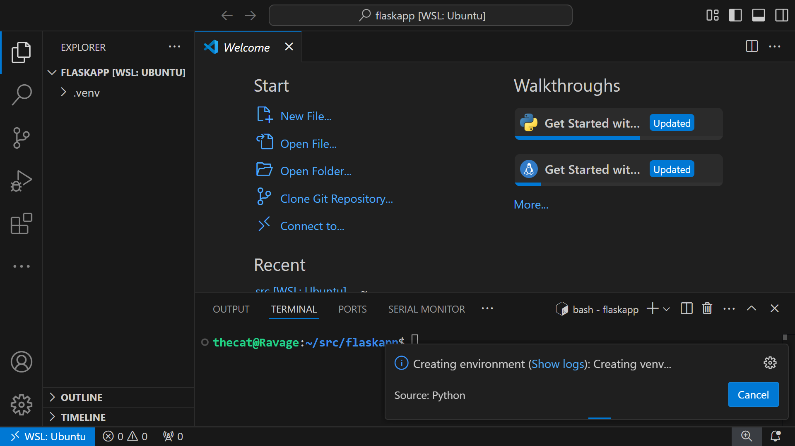

Slide 14
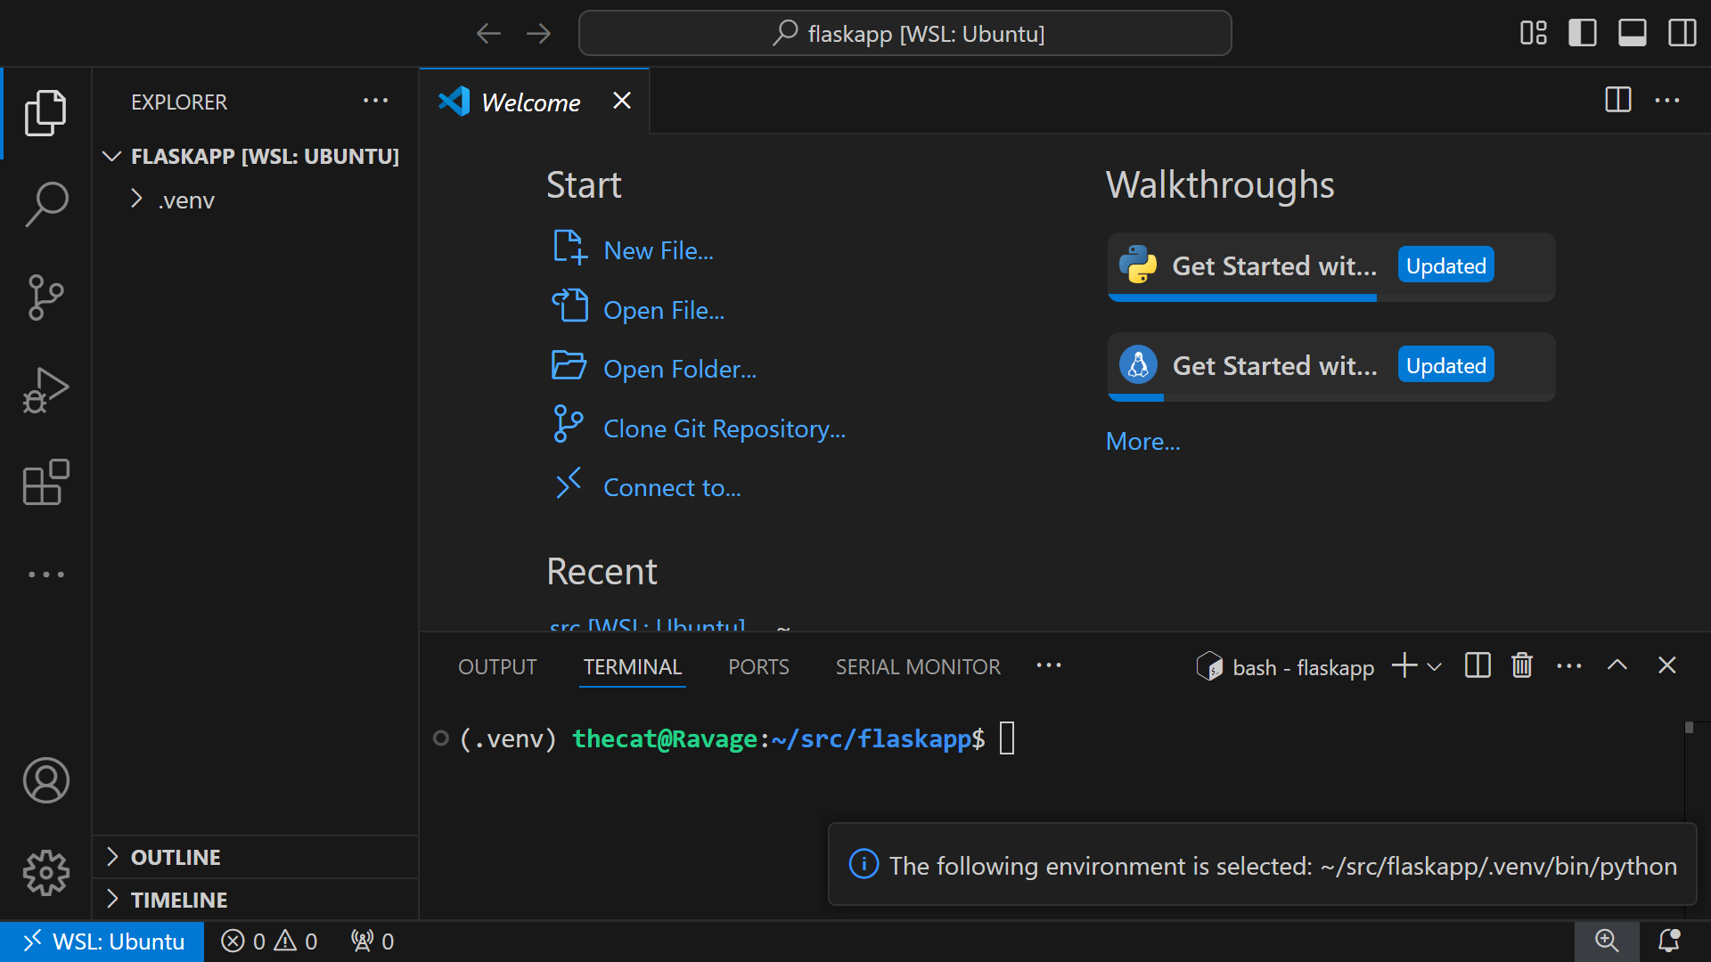

Slide 15
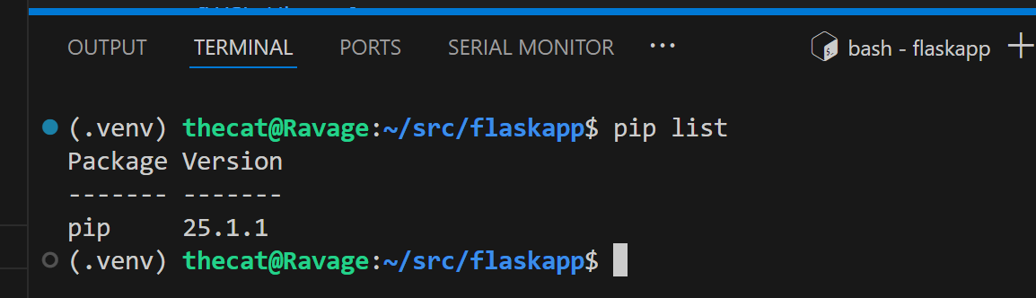

Slide 16
Installing pip
At your computer’s terminal or command prompt, run:
python -m ensurepip -upgrade
(“python” may also be “py” or “python3”)
Test with pip list

Slide 17
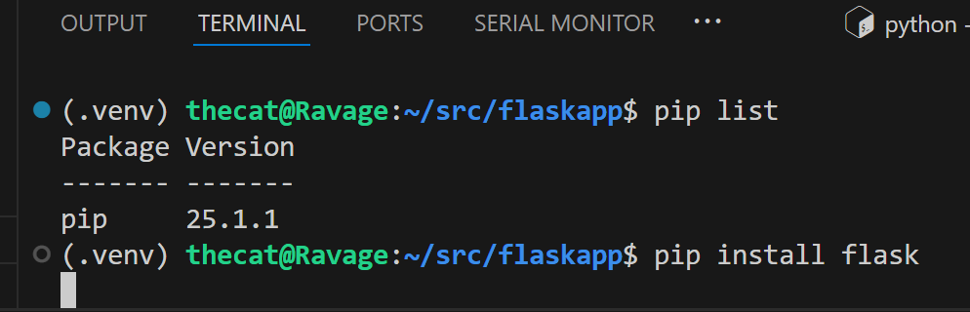

Slide 18
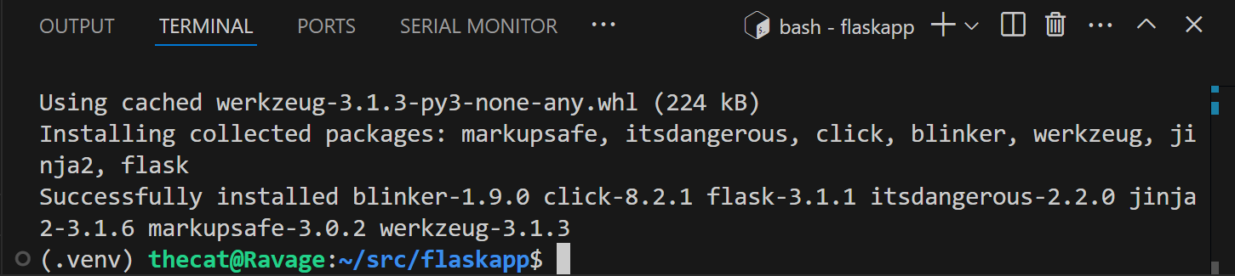

Slide 19
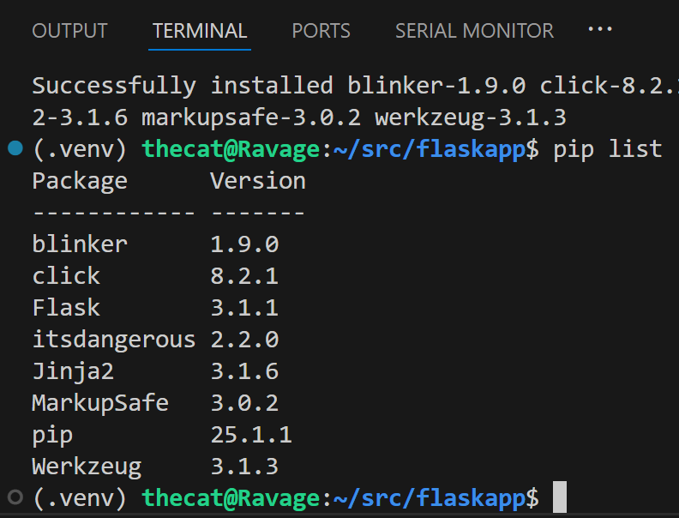

Slide 20
Testing Your Flask Virtual Environment
Create a test Python file
Write code that generates HTML
Run the Flask app instance on your machine
Use your web browser to see the result

Slide 21
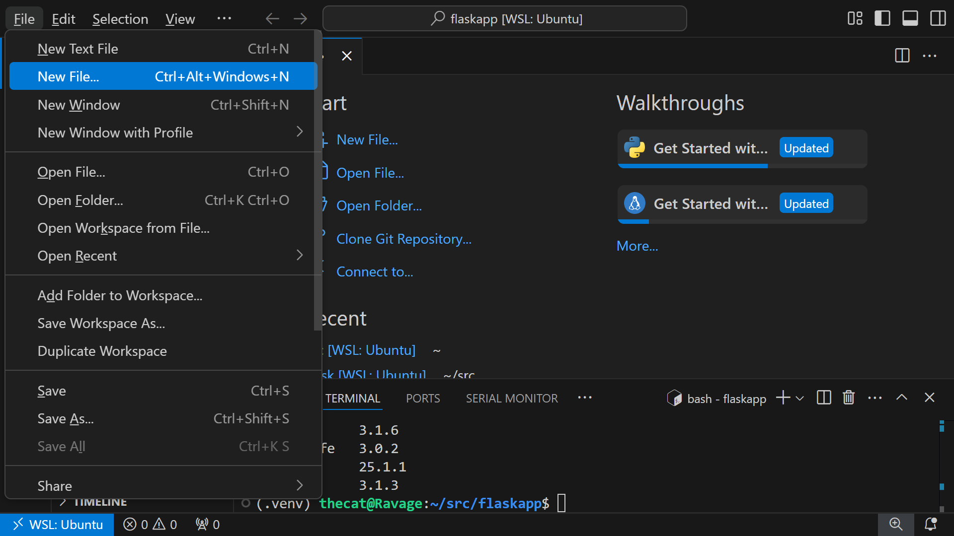

Slide 22
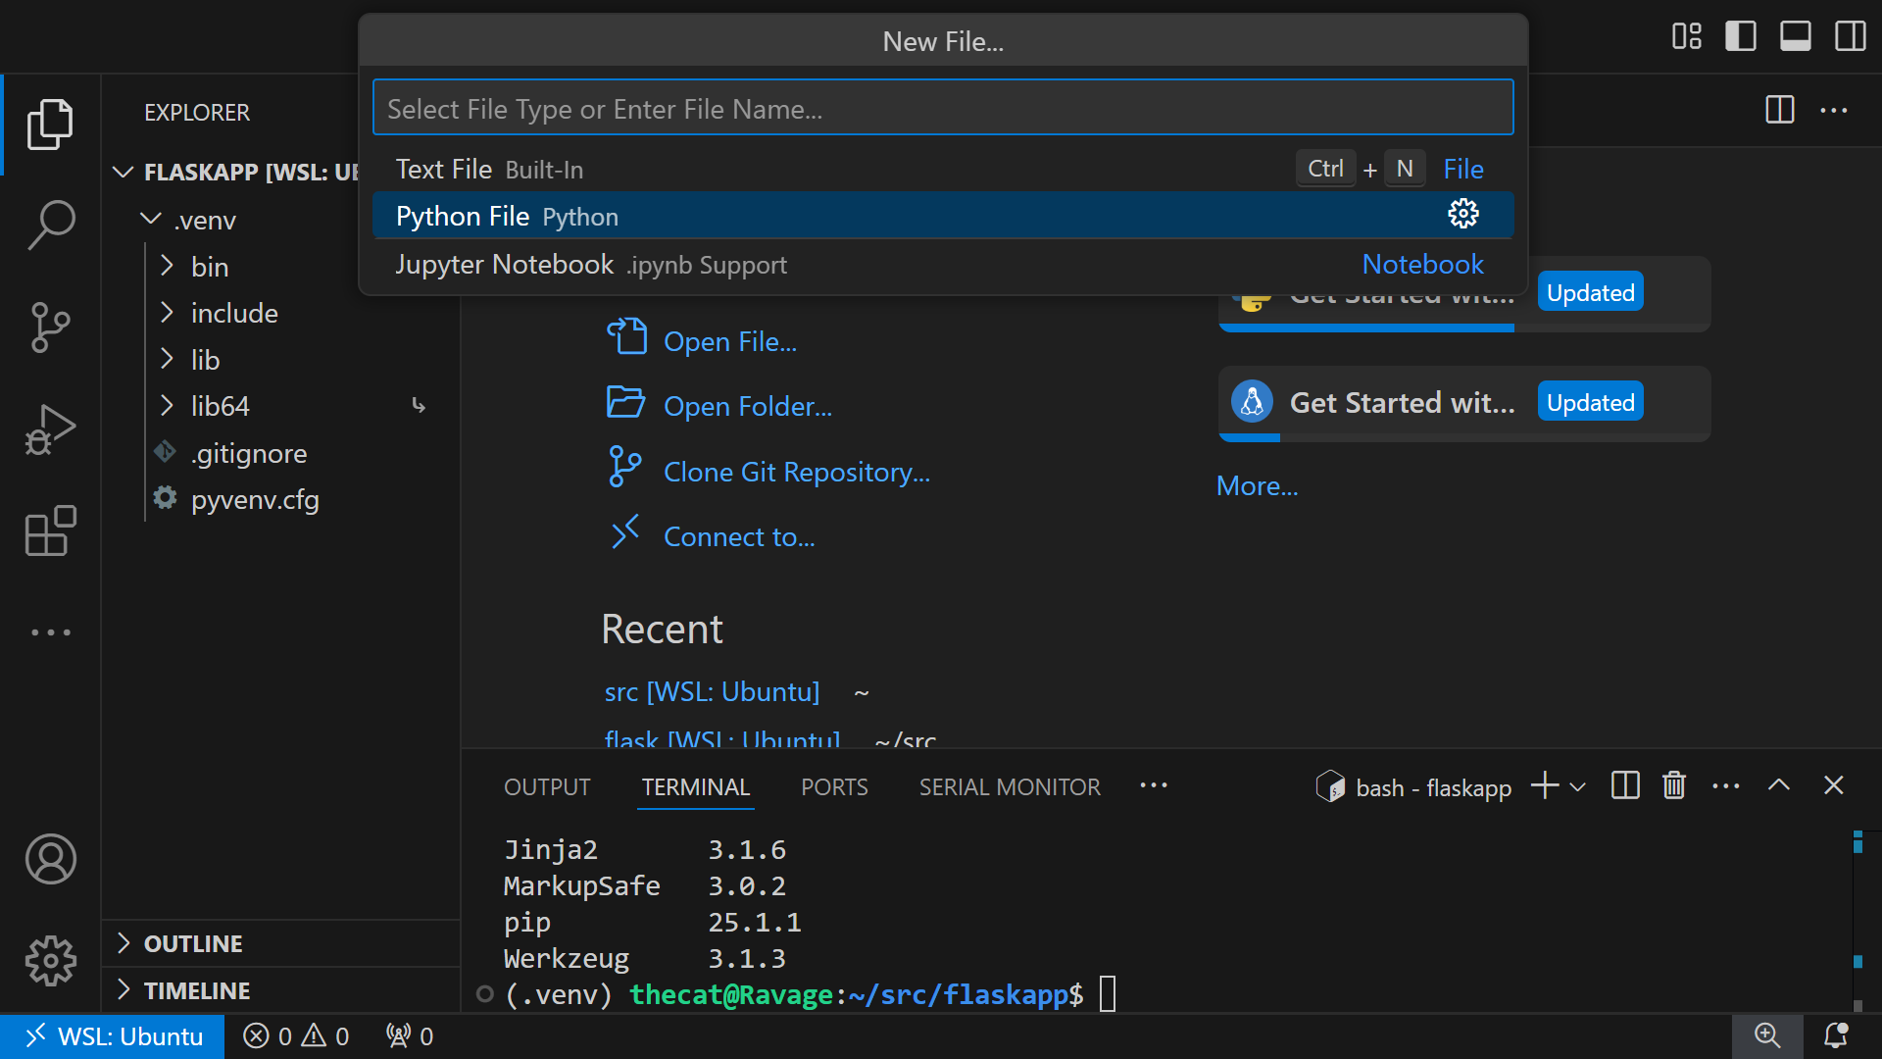

Slide 23
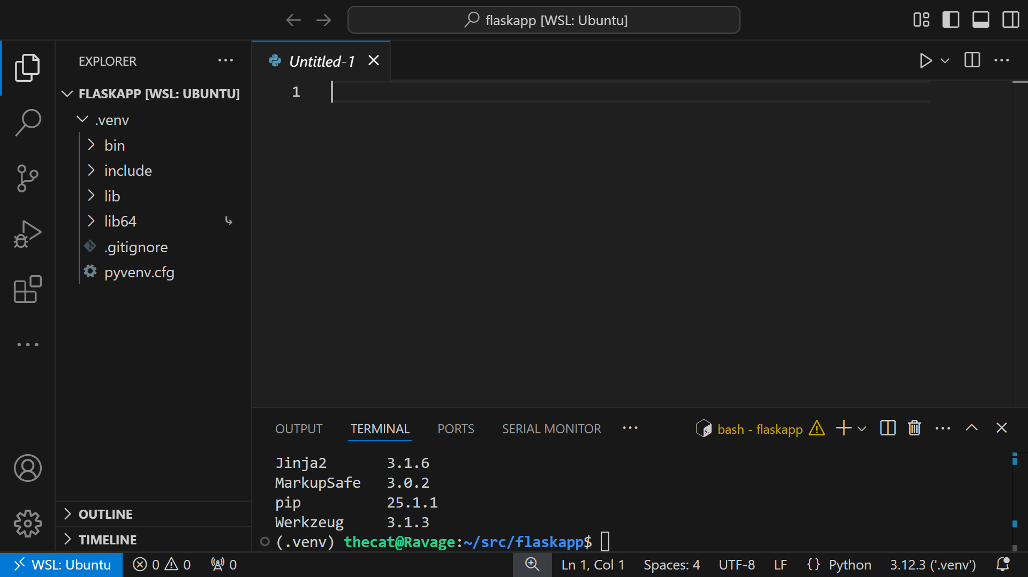

Slide 24
Test Flask Code
from flask import Flask
app = Flask(__name__)
@app.route("/")
def greeting():
return("<p>Hello, world!</p>")

Slide 25
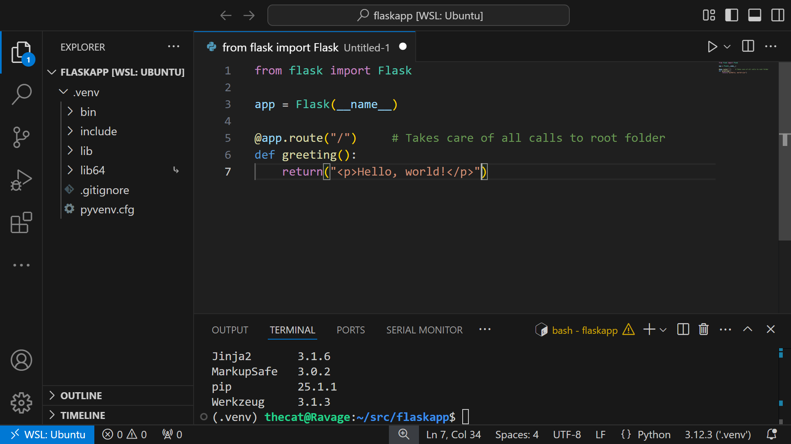

Slide 26
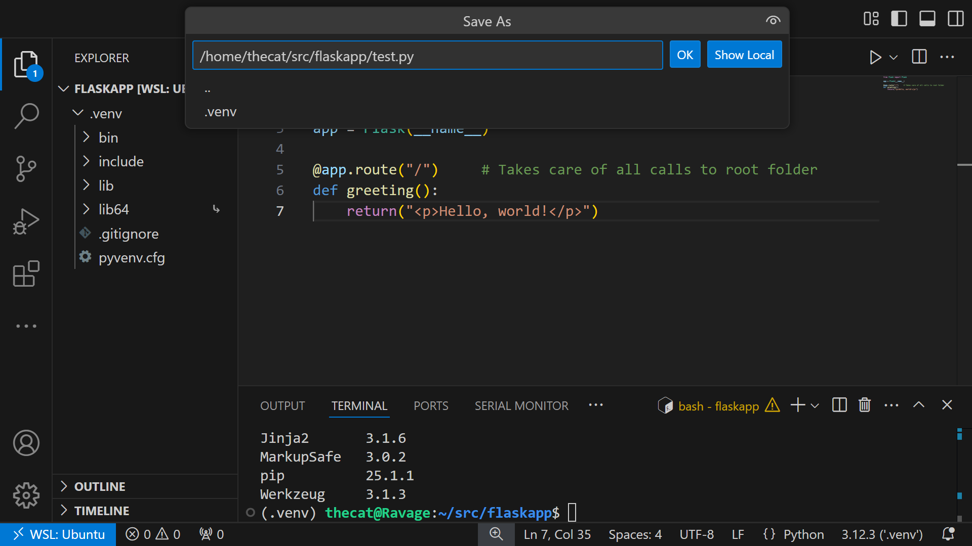

Slide 27
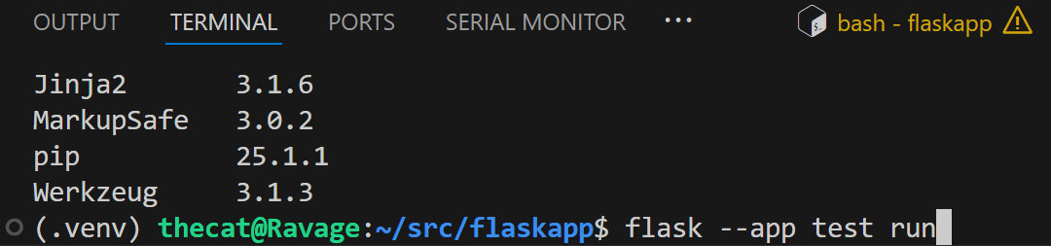

Slide 28
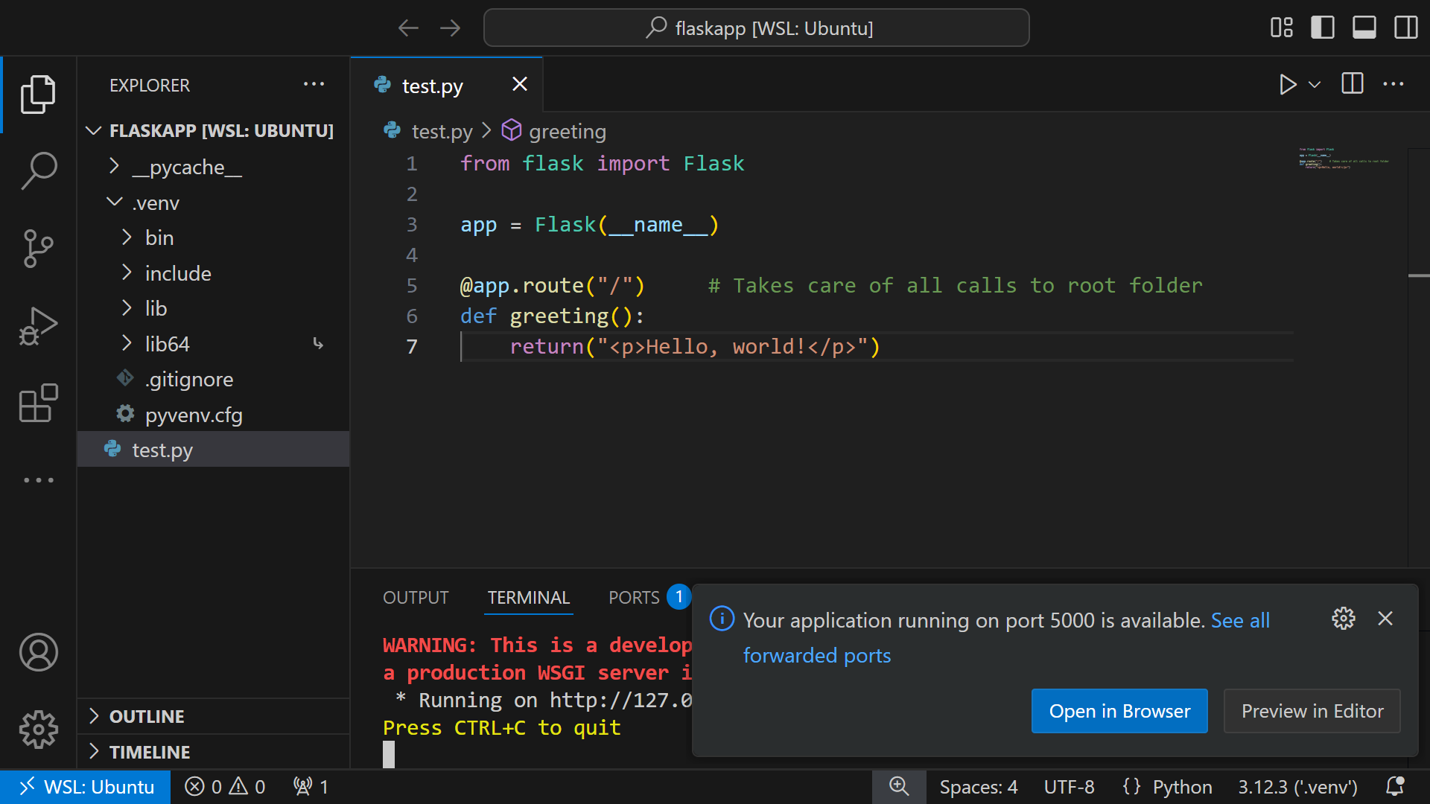

Slide 29
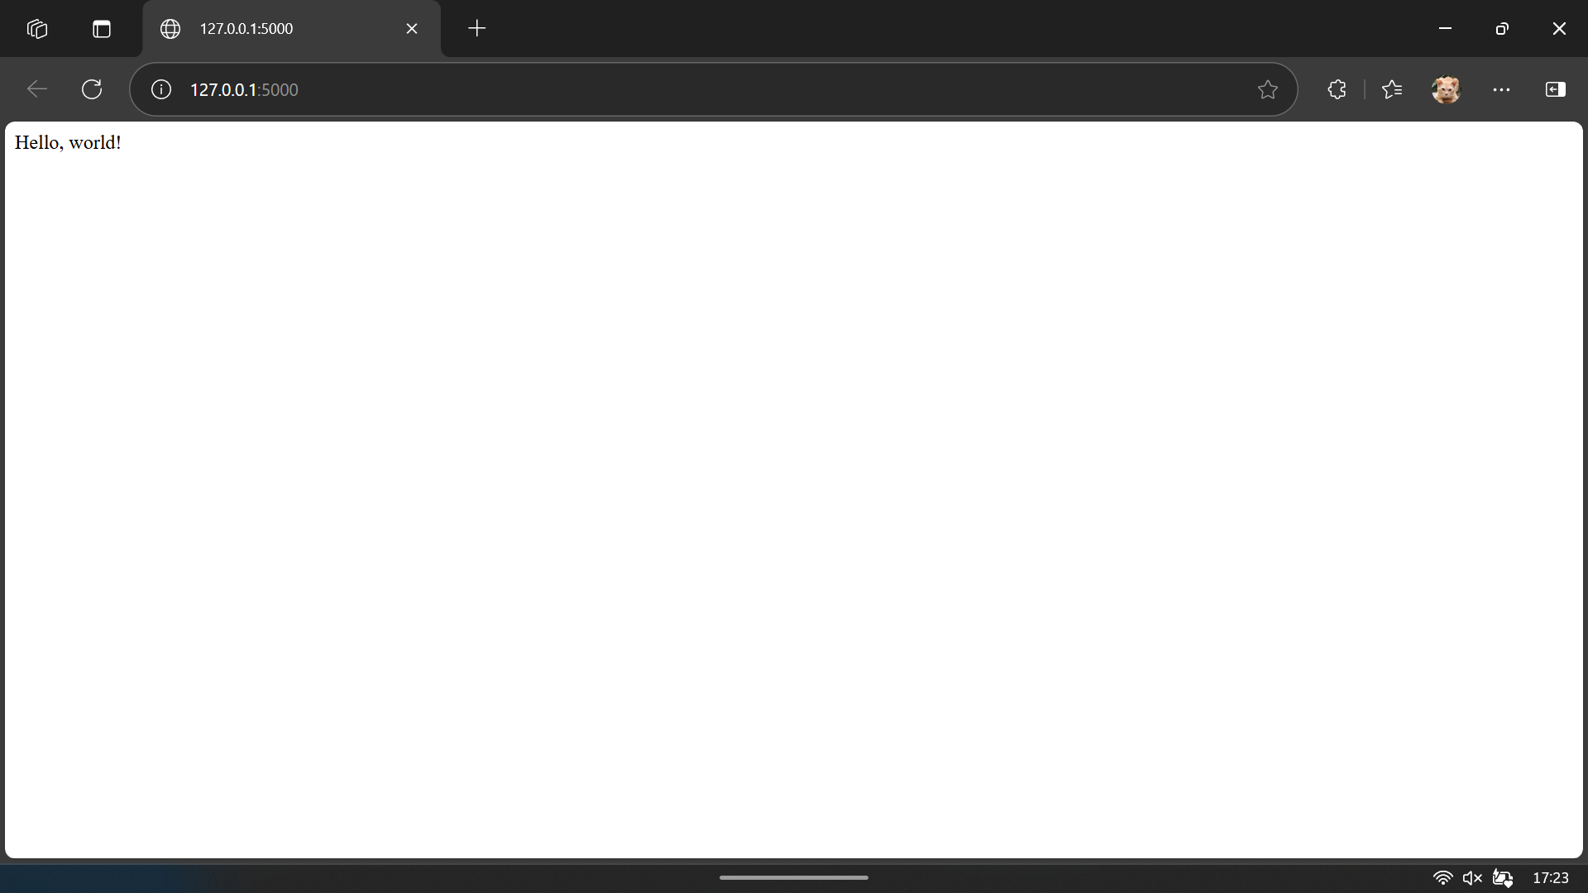

Slide 30
Page Handling
@app.route(urlPath)
def pathHandler():
statements
return htmlString

Slide 31
from flask import Flask
app = Flask(__name__)
@app.route("/")
def greeting():
return("<p>Hello, world!</p><a href='/page1/'>This is a link to Page 1</a>")
@app.route("/page1/")
def page1Handler():
return("<p>This is Page 1</p>")

Slide 32
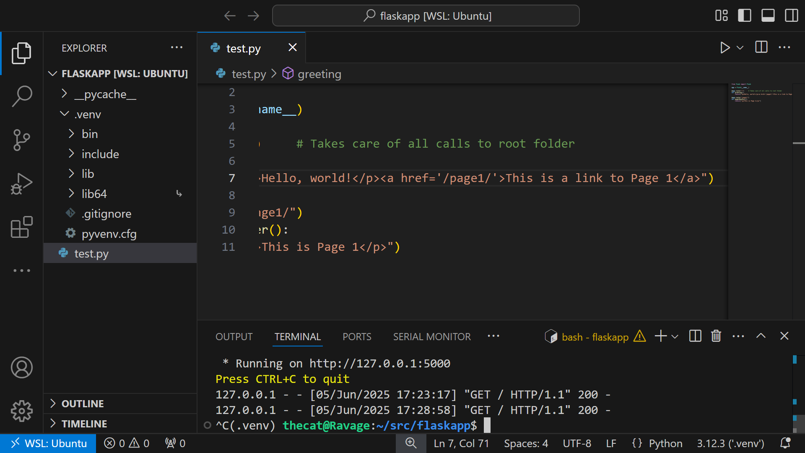

Slide 33
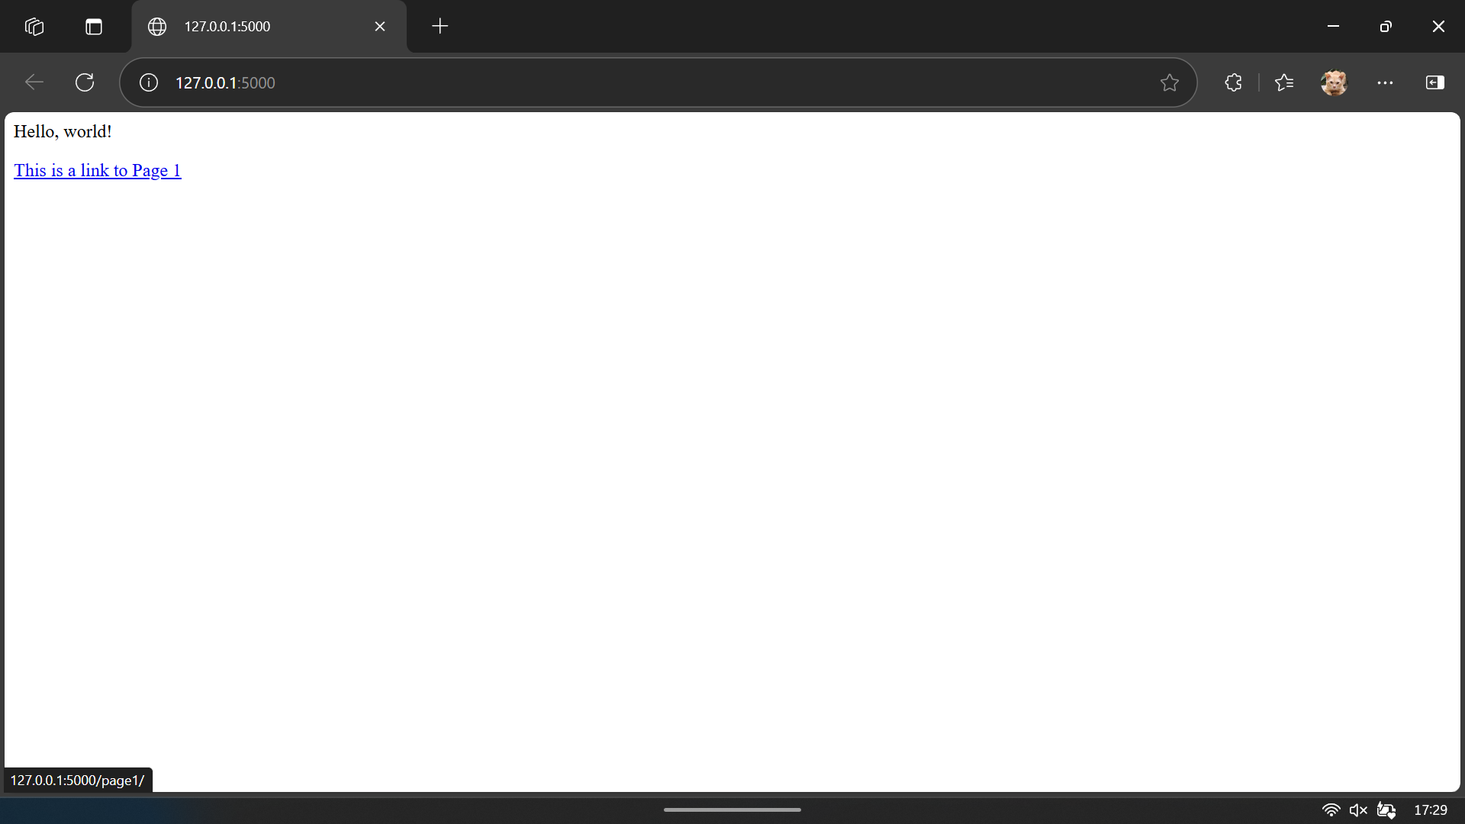

Slide 34


Slide 35
Handling HTML Forms (POST / Response)
In HTML, have a <form>
action= must be caught by a Flask @app.route() function
method= must be post
Form elements must have name= attributes
In Flask
Must import request from flask
@app.route() must match <form action=> link
@app.route() must have methods=["POST"] argument
Access HTML form elements by passing the name into the request.form[] dictionary

Slide 36
from flask import Flask, request
app = Flask(__name__)
@app.route("/")
def mainPage():
html = """<!DOCTYPE html><html><title>Contact List</title>
<body>
<h1>Contact List</h1>
<form action='/addentry' method='post'>
<label for='name'>Name:</label>
<input type='text' id='name' name='name'><br>
<label for='data'>Data:</label>
<input type='text' id='data' name='data'><br>
<input type='submit' value='Add entry'>
</form>
</body>
</html>"""
return html

Slide 37
@app.post("/addentry")
def addEntry():
html = """<!DOCTYPE html><html><title>Contact List</title>
<body>
<h1>Add Entry</h1><p>""" + str(request.form["name"]) + """</p>
<p>""" + str(request.form["data"]) + """</p>
</body>
</html>"""
return html

Slide 38
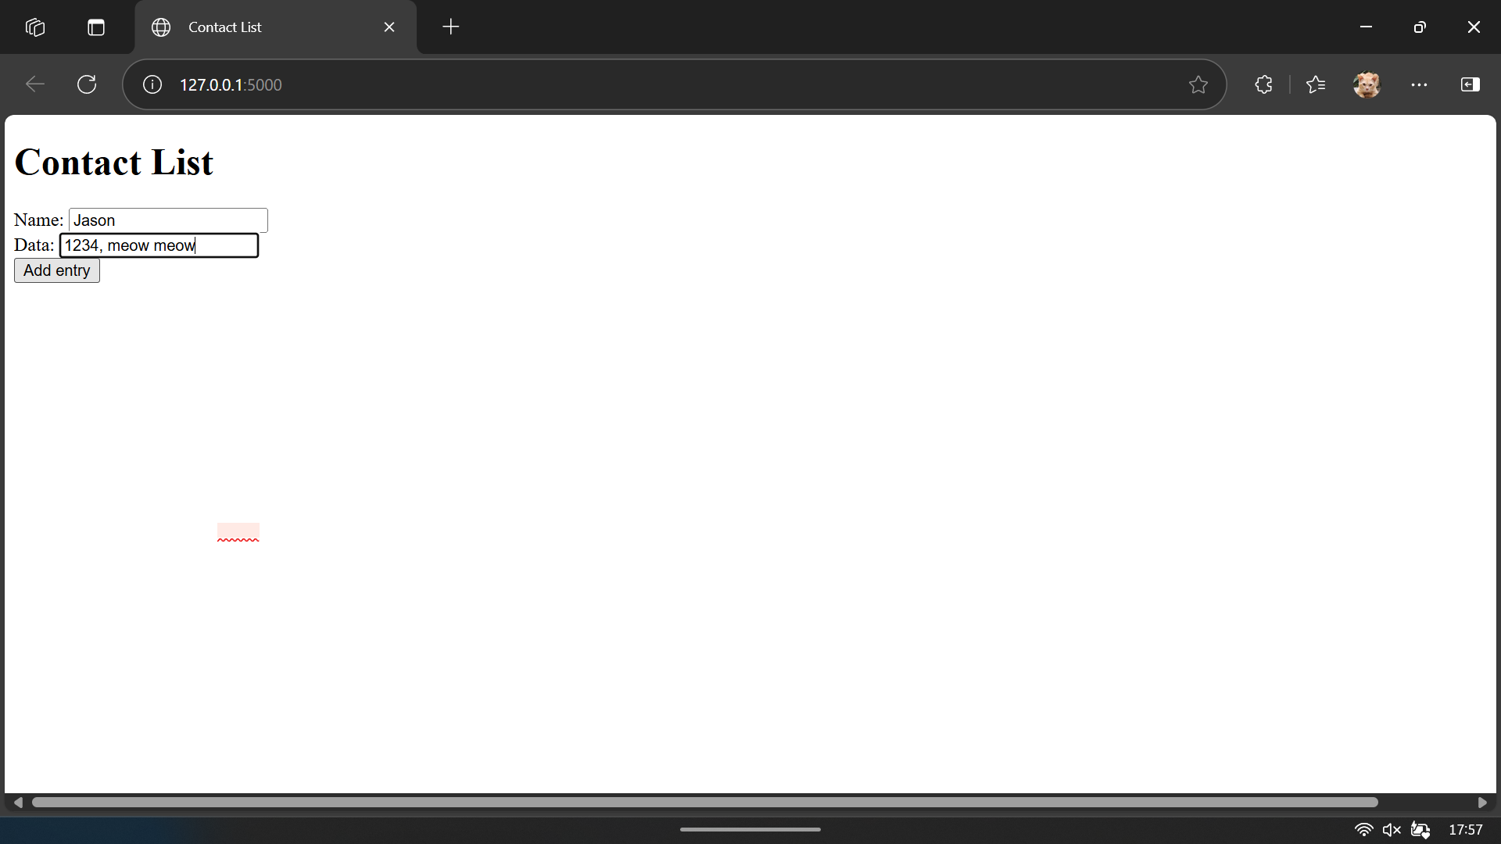

Slide 39
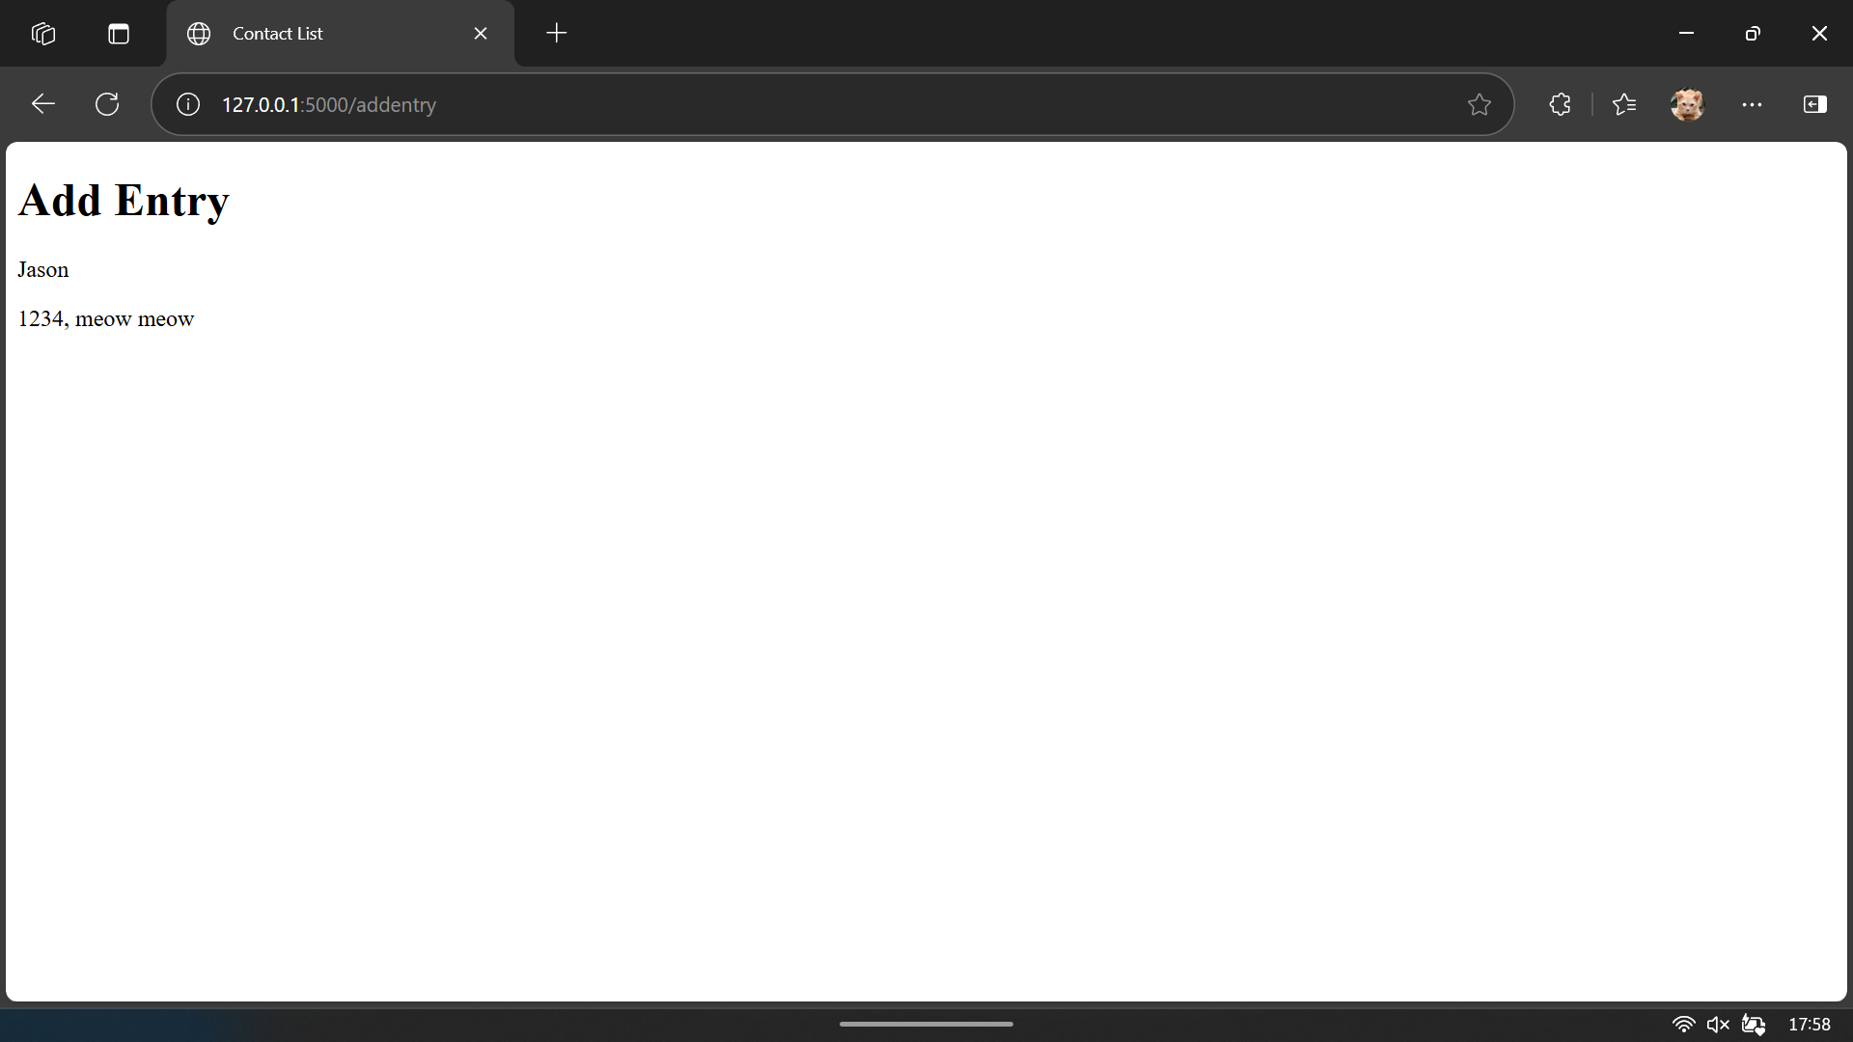

Slide 40
Templated HTML Files
Must be in the templates/ folder
Flask app must include render_template from flask
Can have dynamic elements by adding them as {{ name }} in the HTML
Flask @app.route() handlers can return either:
render_template(htmlTemplateFilename)
render_template(htmlTemplateFilename, htmlElementName = value, …)

Slide 41
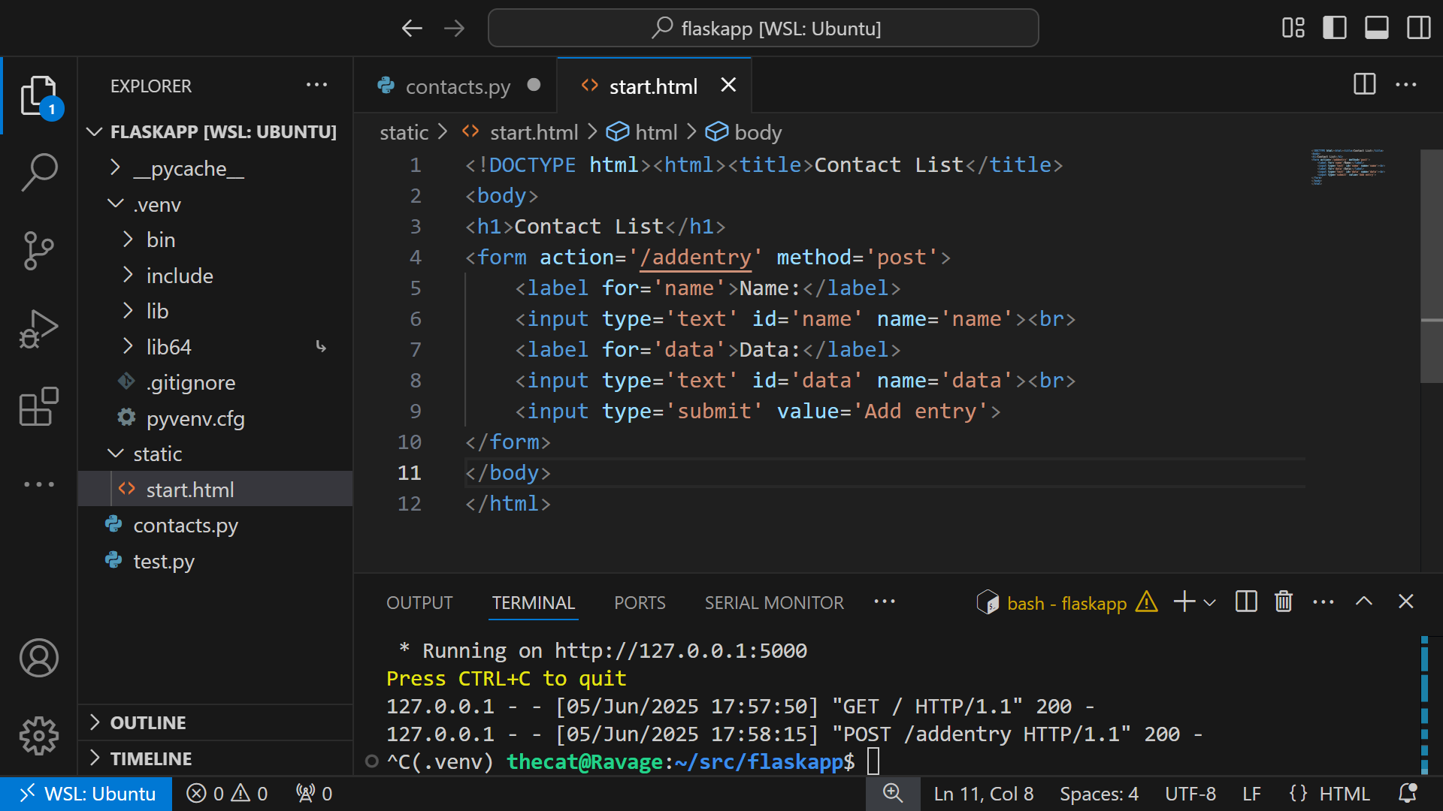

Slide 42
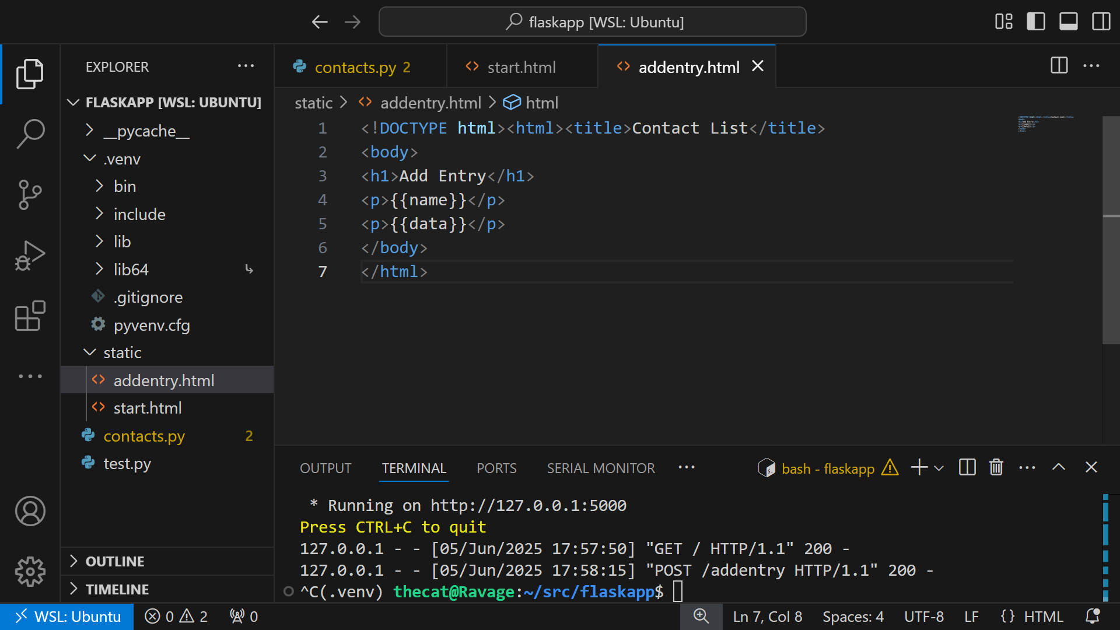

Slide 43
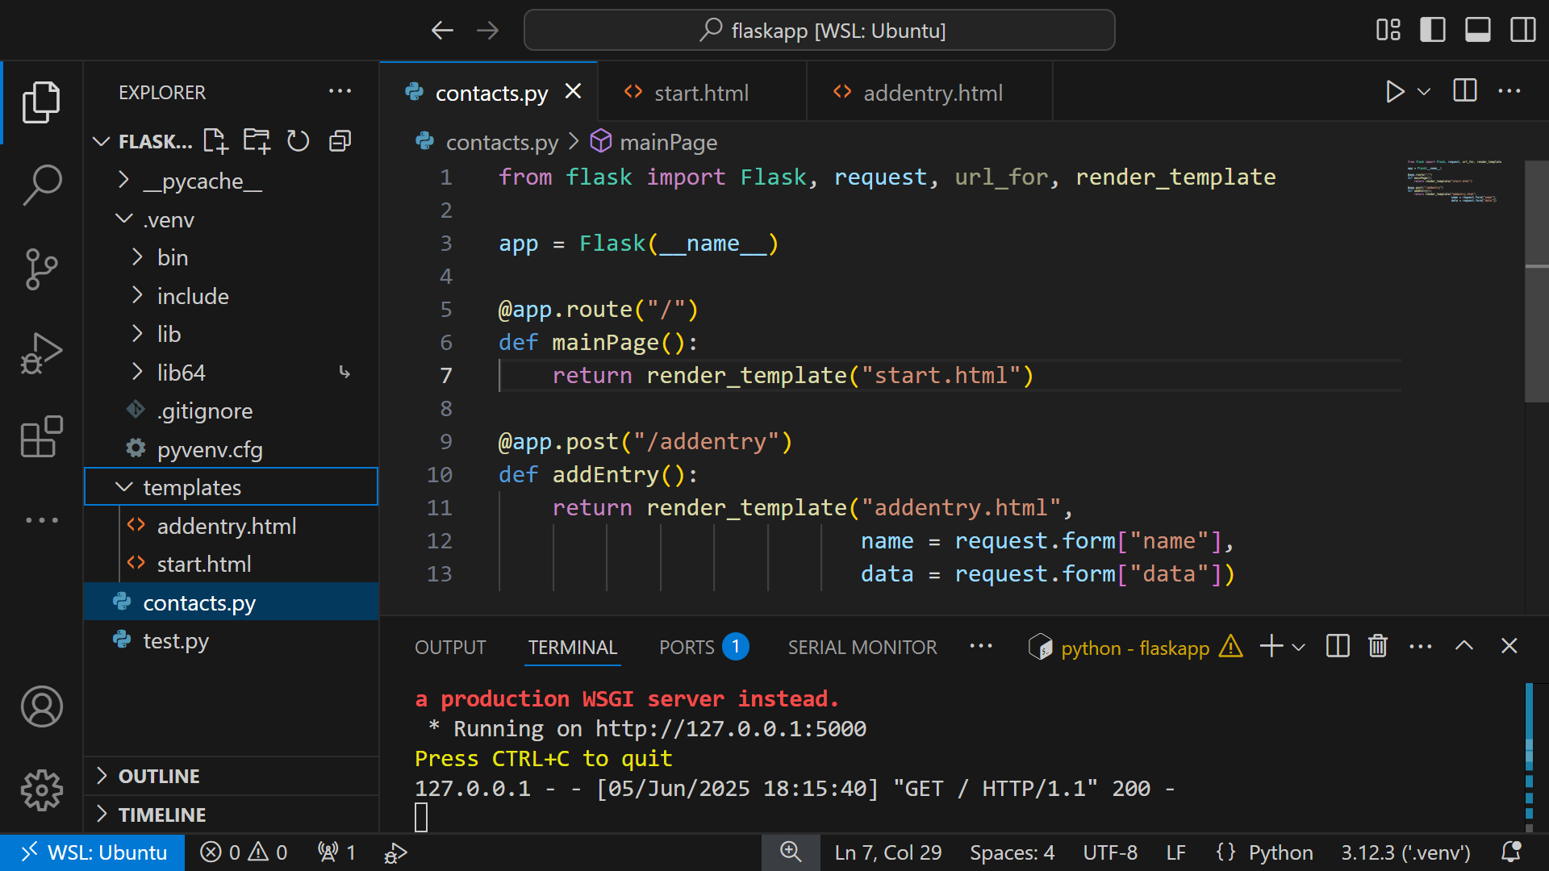

Slide 44
Simple Flask Calculator app (TasneemEltabakh)
https://github.com/TasneemEltabakh/Simple-Flask-Calculator/tree/main

